Slide 1



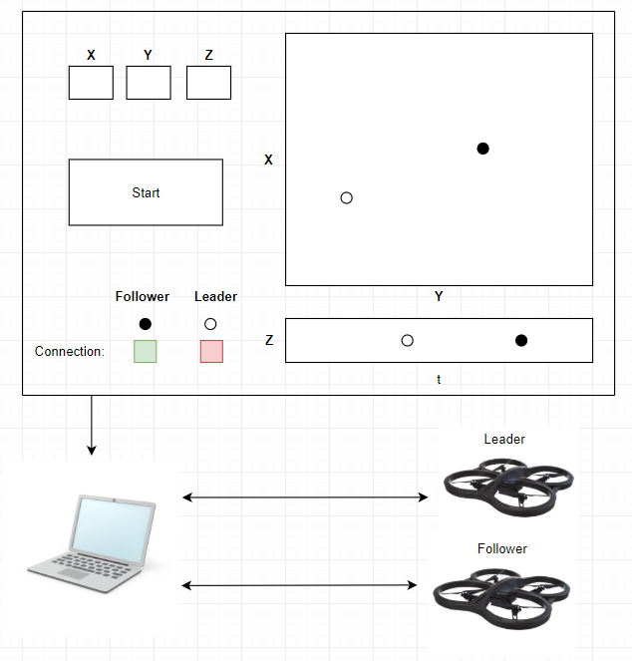
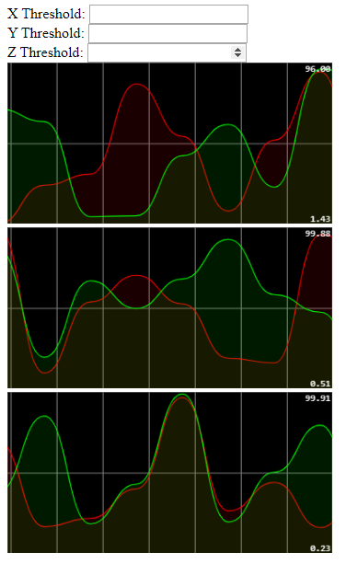

Background
System Diagram
Milestones
In our project, we focus on having an autonomous follower drone to follow a primary leader drone. The project would help improve military technology by exploring ways to allow a single drone to communicate or control multiple autonomous drones.
Create base GUI Interface
Control Parrot AR Drone with laptop with code in JS
Retrieve Parrot AR Drone GPS data on the laptop
Create a graph for GUI to display GPS data
Establish connection from base station GUI to flight control program.
Obstacle detection for follower drone
Progress
Implement a full screen GUI with a real-time graph plot
Integrate GPS data from the drones with GUI
Establish communication channel between drones via base station (laptop)
Control drone through commands sent through laptop
References
Materials
[1] P. Bouman, et al. “Dynamic Programming Approaches for the Traveling Salesman Problem with Drone.” Networks, vol. 72, no. 4, 2018, pp. 528–542.
[2] L. Mottola et al. “Team-Level Programming of Drone Sensor Networks.” Proceedings of the 12th ACM Conference on Embedded Network Sensor Systems - SenSys '14, 2014.
Parrot AR. Drone 2.0
Raspberry Pi
Laptop
GPS Module (2)

